Slide 1
Loan Application
PT. XYZ Fintech Company

Slide 2
Register
Account
Username *
cisnatinnov
Email *
cisnatinnov@gmail.com
Password *
****************
profile

Slide 3
Personal Profile
Profile
First Name *
Mohamad
Middle Name
Cendikia Isnatinnov
Last Name *
Hairy
Birth Date *
25/07/1993
Birth Place *
Bandung
next

Slide 4
Contact
Contact
Telephone
Fax
Handphone
+628998748286
next

Slide 5
Address
Address
Street *
Kp. Dawuan Oncom
NA*
CA*
006
005
Village *
Dawuan Kaler
Subdistrict *
Dawuan
City *
Subang
Province *
Jawa Barat
Postal Code *
41270
Submit

Slide 6
Email Content
This is your OTP Qw3Rtyu1

Slide 7
OTP
OTP
OTP
Qw3Rtyu1
Submit

Slide 8
Login
Login
Username / Email *
cisnatinnov
Password *
****************
Forgot Password
Login
Use Biometric

Slide 9
Biometric
Fingerprint
Camera

Slide 10
Forgot Password
Forgot Password
Email *
cisnatinnov@gmail.com
Submit

Slide 11
Forgot Password
Link to change your password change password

Slide 12
Change Password
Change Password
Password *
****************
Retype Password *
****************
Change Password

Slide 13
Home Page
Available Limit
12.000.000
Apply
This Month Payment
You haven't paid your debt, pay it here

Slide 14
Home Page
Available Limit
12.000.000
Apply
This Month Payment
You've paid off the last bill

Slide 15
Apply
Input nominal
12.000.000
Payment method
Bank AN 007****
3 Months
6 Months
12 Months
Sign The Agreement and Send

Slide 16
Monthly Bill
No | Nominal | Due date
1 | 3.000.000 | 12/11/2023
2 | 3.000.000 | 12/12/2023
3 | 3.000.000 | 12/01/2024

Slide 17
Monthly Bill
No | Nominal | Due date | #
1 | 3.000.000 | 12/11/2023
2 | 3.000.000 | 12/12/2023
3 | 3.000.000 | 12/01/2024

Slide 18
Payment Method
Transfer Bank
Indomaret / iSaku
Alfamaret

Slide 19

Fingerprint
Scan your finger

Slide 20
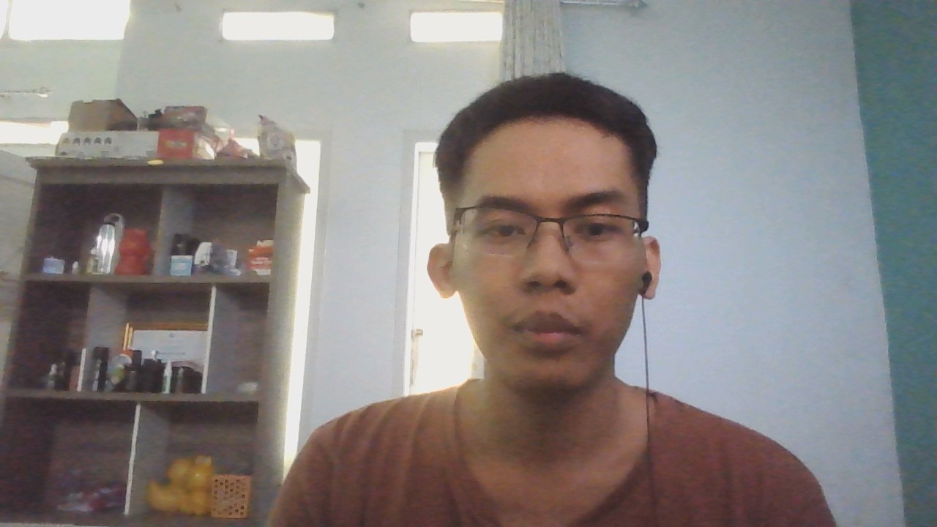
Camera
Scan your face

Slide 21
Transfer Bank
Bank | Account Number | Duration
BRI | 321*********** | 3h 0min 0s
Choose file

Slide 22
Indomaret / iSaku
Bank | Account Number | Duration
BRI | 321*********** | 3h 0min 0s
Choose file

Slide 23
Alfamaret
Bank | Account Number | Duration
BRI | 321*********** | 3h 0min 0s
Choose file

